Slide 1


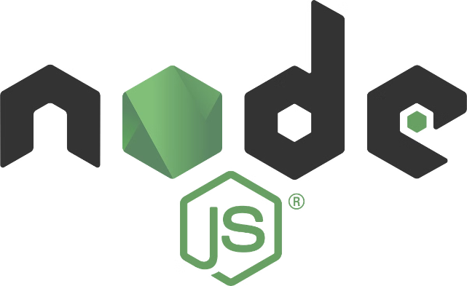


Introduction to Node.js
Node.js is a powerful runtime environment that allows developers to build scalable and efficient server-side applications using JavaScript. It is an open-source, cross-platform, and event-driven JavaScript runtime that executes code outside of a web browser.
by Vivek Singh Parmar

Slide 2

What is a Framework?
Structured Approach
Reusable Components
Flexibility
A framework provides a structured approach to building applications, ensuring consistency and best practices.
Frameworks offer a set of pre-built components and libraries that developers can leverage, saving time and effort.
Frameworks are designed to be customizable, allowing developers to tailor the application to their specific needs.

Slide 3
Popular Node.js Frameworks
Express.js
Koa.js
Sails.js
A minimalist web application framework that provides a robust set of features for web and mobile applications.
A lightweight, expressive, and middleware-focused web framework designed to be a more modern alternative to Express.js.
A backend MVC framework that makes it easy to build custom, enterprise-grade Node.js apps.

Slide 4

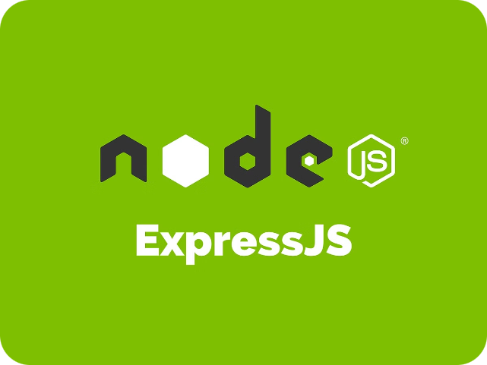
Overview of Express.js
1
Minimalist Design
2
Middleware-Driven
Express.js is a minimal and flexible Node.js web application framework that provides a robust set of features for web and mobile applications.
Express.js uses a middleware-driven approach, allowing developers to easily add or remove functionality as needed.
3
Simplifies Web Development
Express.js abstracts away many of the low-level details of HTTP, making it easier to build web applications and APIs.

Slide 5

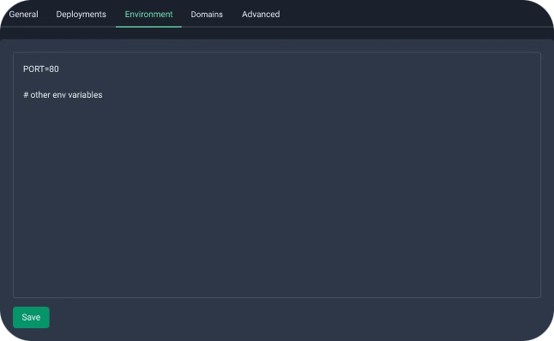
Setting up an Express.js Application
1
Install Express
Begin by installing the Express.js package using npm, the Node.js package manager.
2
Create a Server
Set up a basic server that listens for incoming HTTP requests and sends a response.
3
Define Routes
Create routes to handle different URLs and map them to the appropriate functionality.

Slide 6


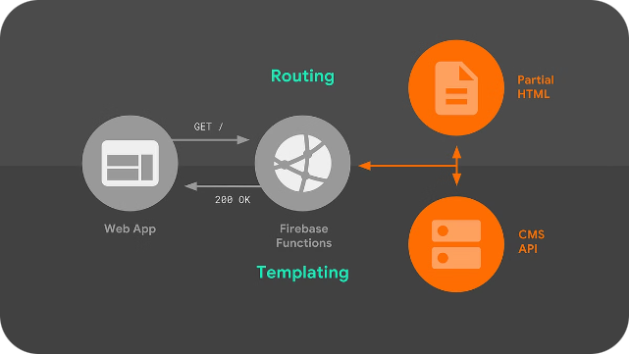


Routing in Express.js
URL Matching
Express.js uses a simple and intuitive syntax for defining routes based on URL paths.
HTTP Methods
Developers can specify which HTTP methods (GET, POST, PUT, DELETE, etc.) should be handled by each route.
Route Parameters
Routes can include dynamic parameters that can be accessed within the route handler function.

Slide 7


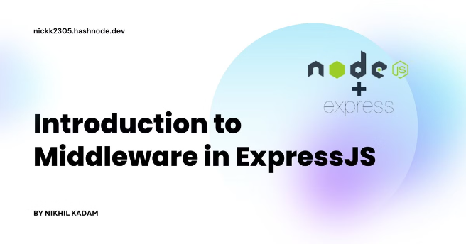


Middleware in Express.js
Request Processing
Middleware functions can be used to modify or enhance the incoming request object.
Response Handling
Middleware can also be used to manipulate the outgoing response object before it is sent to the client.
Error Handling
Express.js provides a centralized way to handle errors that occur during the request-response cycle.

Slide 8

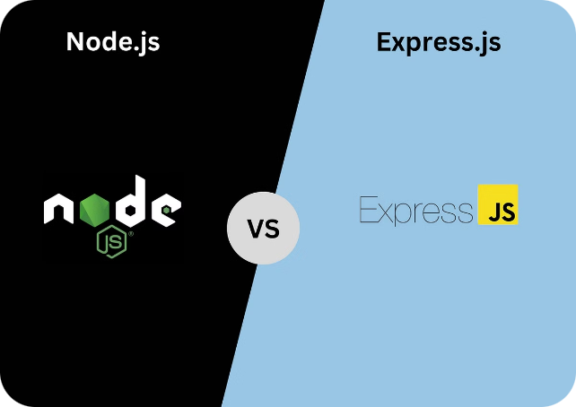
Conclusion and Key Takeaways
1
Powerful Runtime
2
Frameworks Simplify Development
Node.js is a powerful runtime environment that allows developers to build scalable and efficient server-side applications using JavaScript.
Frameworks, like Express.js, provide a structured approach and reusable components, making web development more efficient and flexible.
3
Express.js Essentials
Express.js is a minimalist, middleware-driven web framework that simplifies the process of building web applications and APIs.

